Slide 1
D77_PWM DRAWER
By Fares Ellakany

Slide 2
PWM DRAWER – Real-Time PWM Signal Visualization
Based on ATmega32 Microcontroller
Presented by: [Fares Ellakany]
Date: [25/5/2025]

Slide 3
Project Overview
Purpose:
To visualize and analyze PWM signals in real-time
Platform: ATmega32 Microcontroller
Display: Graphical LCD (GLCD

Slide 4
Project Overview
Key Features:
Capture external PWM signals
Display duty cycle & frequency
Generate test PWM signal

Slide 5
Why PWM Signal Visualization?
PWM is widely used in:
Motor control
LED dimming
Communication systems
Understanding PWM characteristics is crucial for:
Debugging electronics projects
Teaching embedded systems

Slide 6
Core Components ATmega32 Microcontroller
ATmega32 Microcontroller
Input Capture Unit (ICU)
Graphical LCD (GLCD)
PWM Generator Module
User Interface (Buttons, Potentiometer, etc.)

Slide 7
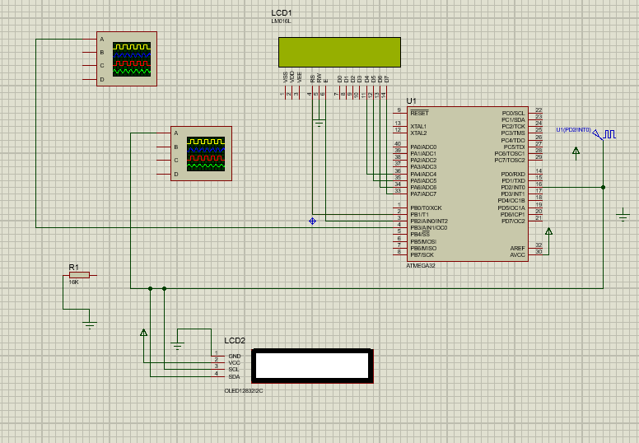
System Architecture
PWM Signal Input → ICU → Data Processing → GLCD Output
PWM Generator → Output Pin

Slide 8
PWM Signal Capture
Input Capture Unit (ICU) used to:
Measure frequency
Calculate duty cycle
Timer/Counter1 of ATmega32 is configured for precise time measurements

Slide 9
Data Processing
Pulse width and period measured
Duty Cycle (%) = (High Time / Period) × 100
Frequency = 1 / Period
Data formatted for display

Slide 10
Graphical LCD Display GLCD shows:
Live waveform representation
Numeric values: frequency & duty cycle
Visual format helps in:
Instant signal analysis
Educational demonstrations

Slide 11
PWM Signal Generation Internal module generates customizable PWM signals
Adjustable parameters:
Frequency
Duty cycle
Useful for:
Simulation
Device testing
Educational use

Slide 12
Applications Educational labs
Embedded systems debugging
PWM-based system development
Microcontroller training courses

Slide 13
Advantages Real-time signal monitoring
Standalone operation
Custom test signal generation
Easy to interpret graphical dat

Slide 14
Future Enhancements Data logging to SD card
USB/Serial interface for PC monitoring
Touch-based UI
Multi-channel PWM analysis

Slide 15
Conclusion
PWM DRAWER provides an intuitive way to study and test PWM signals
Enhances learning, debugging, and development in embedded systems
Combines hardware and software for an interactive experience

Slide 16
Q&A
Thank You!

